Slide 1

Discrete TRENCHSTOP™ IGBT7 family
Infineon Technologies
September 2025

Slide 2





Agenda
1
Commercial overview
2
Technology background
3
5 values of discrete IGBT7 family
4
Key takeaways and resources
Notes:
Decisive 5 Values

Slide 3


Comercial overview

Slide 4

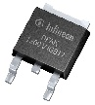
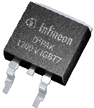
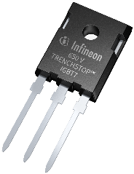
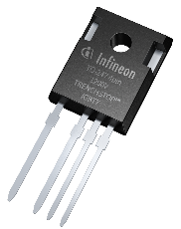
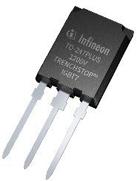
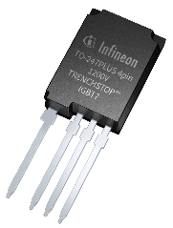

It´s time to Switch! 5 Decisive Values of TRENCHSTOPTM IGBT7 family
Value Proposition
Customer benefits
Product features
Ease of Use
One family to fulfill the overall power application needs
Easy to switch, fine controllability with a rugged transient. Flexible family to replace most predecessor technologies. 61 Products in 7 different packages
Power Density
Space minimization or increased output power for the same system size
First time Infineon offer Power discrete devices up to 140 A for 1200 V and up to 150 A for 650 V and 750 V
Efficiency
More output current, lower case temperature
Lowest power losses compared to previous generation
Voltage Class
650 V
750 V
1200 V
System cost
Best system performance and good price/performance ratio
Bridging the gap between traditional silicon IGBTs and offering a cost-effective alternative to wide-bandgap solutions
Current Class
3 A
…
150 A
Quality
Extra reliability, even in high-humidity environment
Qualified by standard for HV-H3TRB
Switching Frequency
2 – 100 kHz
Link to 5 Decisive Values of IGBT7 report!
www.infineon.com/discreteIGBT7

Slide 5
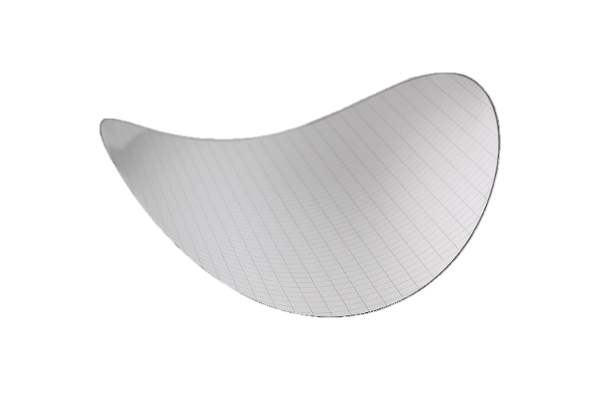


Product vision
3 voltage classes 650 V, 750 V & 1200 V
3 flavors T7, H7 & S7
7 packages
61 products
Benchmark performance
with state-of-the-art quality and best price/performance ratio
Flexible family
to replace almost all predecessor technologies
Manufacturing footprint
IGBTs Produced in a newest fully-automated 300mm chip factory

Slide 6
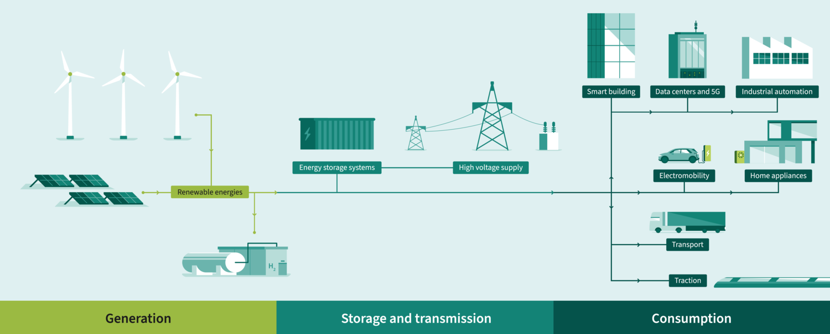

TRENCHSTOP™
S7&T7
UPS
H7
Drives
Fulfill the overall energy chain needs
T7
H7
Heat pump
S7&T7
H7
EV Charging
Solar
Energy storage systems
H7
H7
Fuel cell
S7
CAV
Generation
Storage and transmission
Consumption

Slide 7
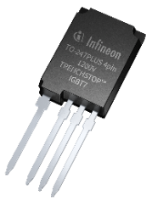
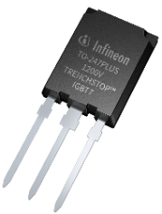
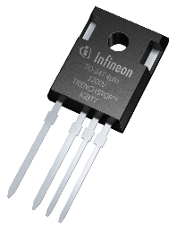
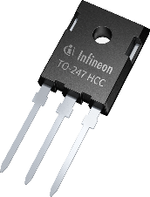
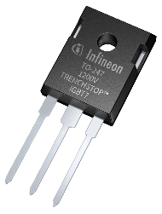



TRENCHSTOP™ IGBT7 – 650 V, 750 V and 1200 V H7
5 packages
H7 technology offers uncompromising performance and full utilization of it´s capabilities
H7
IKY
IKQ
IKZA
IKWH
IKW
38 products
3 voltage classes
650 V
750 V
1200 V
Supreme Performance
40 A | 50 A | 75 A | 100 A | 120 A | 140 A | 150 A

Slide 8
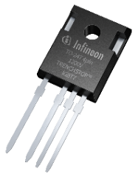
TRENCHSTOPTM IGBT7 H7 family for solar, ESS and EV charging applications
 | Current Inom | TO-247-3-HCC high creepage, high clearance | TO-247-3 | TO-247-4pin asymmetric | TO-247PLUS-3pin | TO-247PLUS-4pin
650 V | 40 A | IKWH40N65EH7 |  | IKZA40N65EH7
 | 50 A | IKWH50N65EH7 |  | IKZA50N65EH7
 | 75 A | IKWH75N65EH7 |  | IKZA75N65EH7
 | 100 A | IKWH100N65EH7 |  | IKZA100N65EH7
 | 120 A |  |  |  | IKQ120N65EH7 | IKY120N65EH7
 | 150 A |  |  |  | IKQ150N65EH7 | IKY150N65EH7
750 V | 50 A | IKWH50N75EH7 |  | IKZA50N75EH7
 | 75 A | IKWH75N75EH7 |  | IKZA75N75EH7
 | 100 A | IKWH100N75EH7 |  | IKZA100N75EH7
 | 120 A |  |  |  | IKQ120N75EH7 | IKY120N75EH7
 | 150 A |  |  |  | IKQ150N75EH7 | IKY150N75EH7
1200 V | 40 A |  | IKW40N120CH7 | IKZA40N120CH7
 | 50 A |  | IKW50N120CH7 | IKZA50N120CH7 | IKQ50N120CH7 | IKY50N120CH7
 | 75 A |  | IKW75N120CH7 | IKZA75N120CH7 | IKQ75N120CH7 | IKY75N120CH7
 | 100 A |  |  |  | IKQ100N120CH7 | IKY100N120CH7
 | 120 A |  |  |  | IKQ120N120CH7 | IKY120N120CH7
 | 140 A |  |  |  | IKQ140N120CH7 | IKY140N120CH7
New Release: October 2025

Slide 9
TRENCHSTOPTM IGBT7 H7 family for solar, ESS and EV charging applications
Value Proposition
Customer benefits
Product features
Ease of Use
Uncompromising performance and full utilization
Easy to switch, developed to fulfill the demand in green energy and efficient applications
Power Density
Maximize system output power
Highest power density, first on the market with 140A rating in 1200V and 150A for 650 V and 750 V discrete devices
Voltage Class
650 V
Efficiency
Uncompromising performance and full utilization
Best in class conduction and switching power losses performance
750 V
1200 V
Current Class
40 A
120 A
System cost
Best system performance and good price/performance ratio
A cost-effective alternative to wide-bandgap solutions
50 A
140 A
75 A
150 A
100 A
Quality
Extra reliability, even in high-humidity environment
Qualified by JEDEC standard for HV-H3TRB
Switching Frequency
16 – 100 kHz

Slide 10
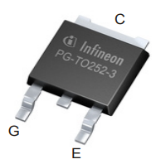
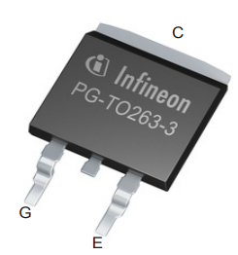

TRENCHSTOP™ IGBT7 – 650 V and 1200 V T7/S7
5 packages
T7 and S7 technology is the ultimate choice for robust performance and precise control with a Short Circuit Withstand Time (3-8µs)
T7/S7
IGD
IGB
IKW / IGW
IKZA
IKQ / IGQ
23 products
2 voltage classes
650 V
1200 V
Short Circuit Robustness
3A | 8 A | 15 A | 20 A | 25 A | 30 A | 40 A | 50 A | 75 A | 100 A | 120 A

Slide 11
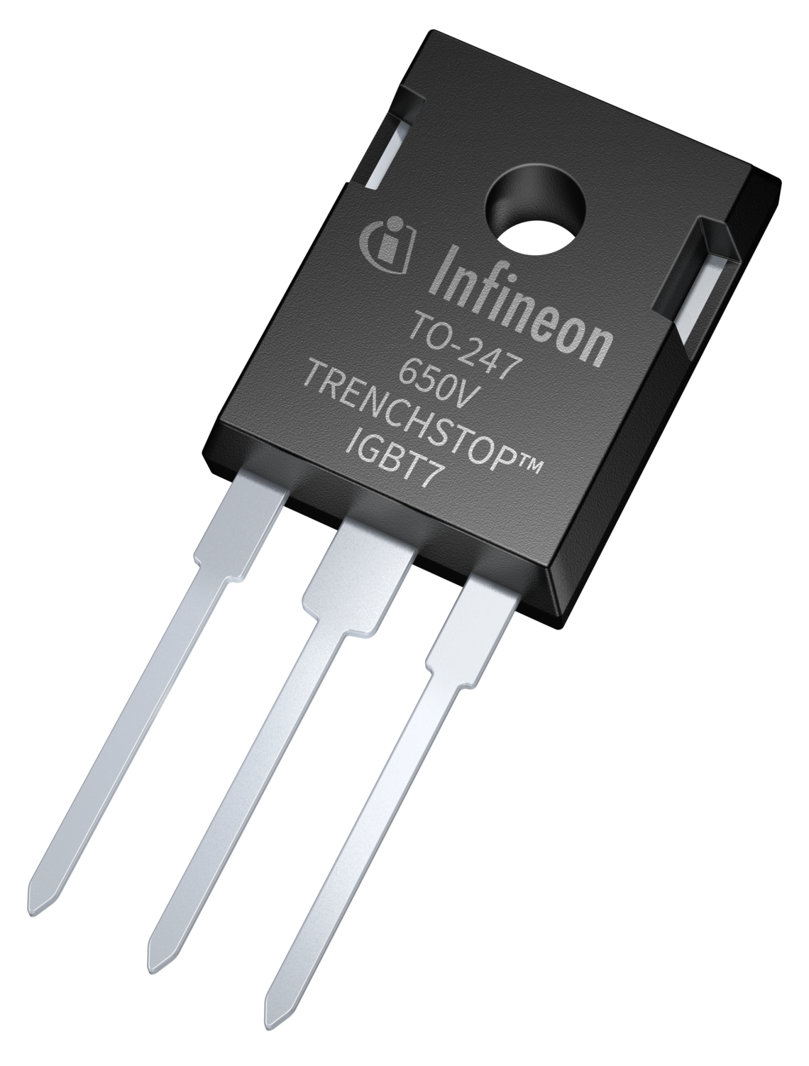
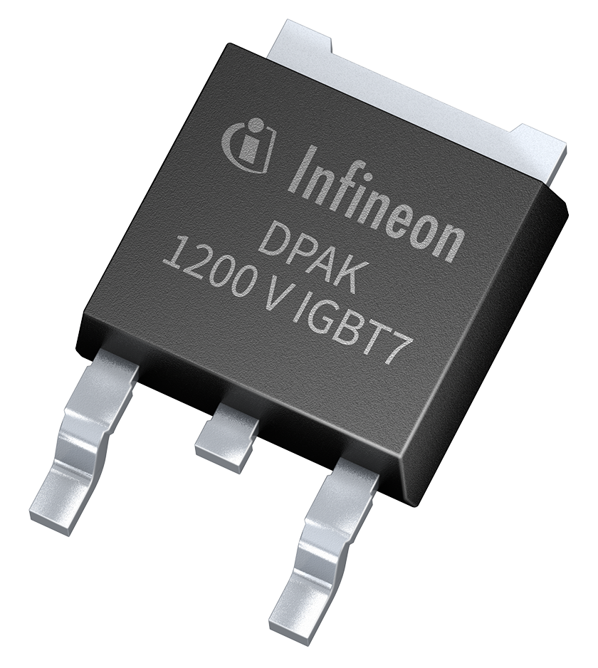
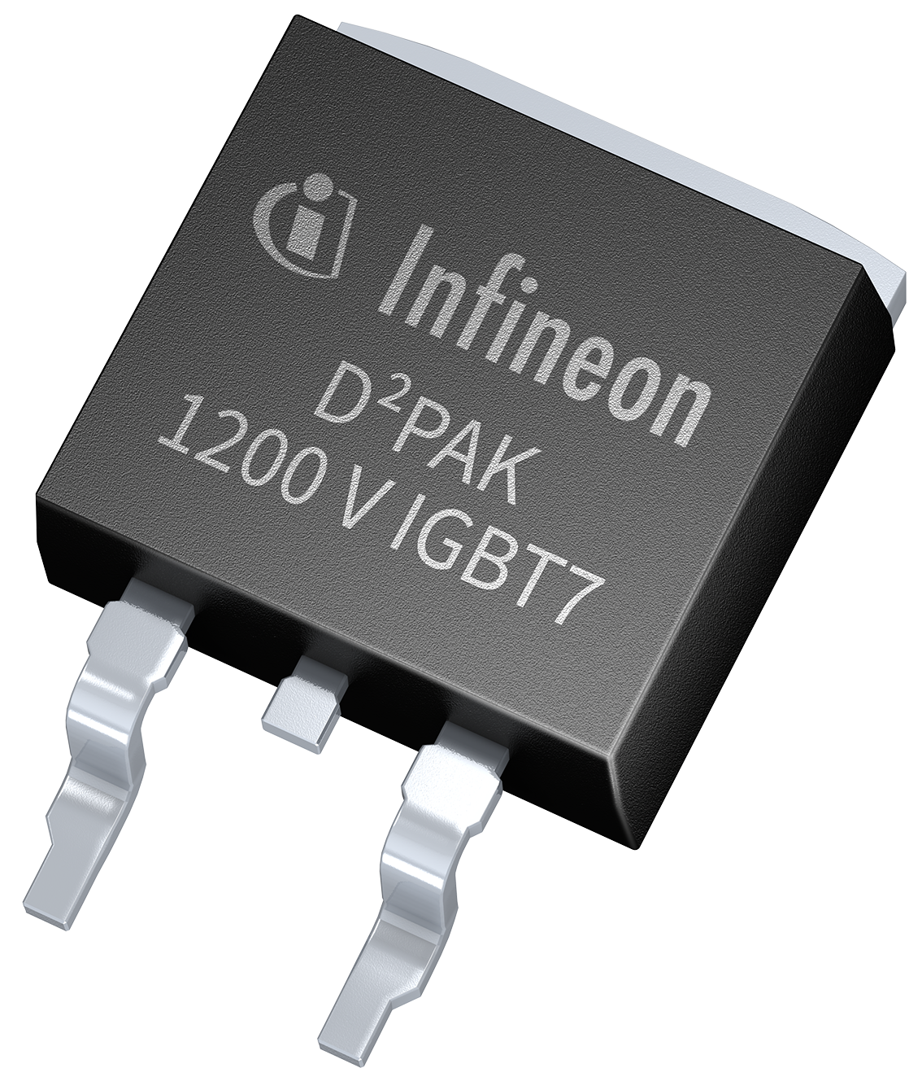
TRENCHSTOPTM IGBT7 T7/S7 family for applications where short circuit is required (e.g. Motor Drive)
 | Current Inom | TO-252-3-11 DPAK | TO-263-3-2 D2PAK | TO-247-3 | TO247PLUS-3pin Copacked with full rated diode | TO247PLUS-3pin Single IGBT
650 V | 20 A |  |  | IKW20N65ET7
 | 30 A |  |  | IKW30N65ET7
 | 40 A |  |  | IKW40N65ET7
 | 50 A |  |  | IKW50N65ET7
 | 75 A |  |  | IKW75N65ET7
1200 V | 3 A | IGD03N120S7 | IGB03N120S7
 | 8 A | IGD08N120S7 | IGB08N120S7 | IKW08N120CS7
 | 15 A |  | IGB15N120S7 | IKW15N120CS7
 | 25 A |  |  | IKW25N120CS7
 | 40 A |  |  | IKW40N120CS7
 | 50 A |  |  | IKW50N120CS7
 | 75 A |  |  |  | IKQ75N120CS7 | IGQ75N120S7
 | 100 A |  |  |  | IKQ100N120CS7 | IGQ100N120S7
 | 120 A |  |  |  | IKQ120N120CS7 | IGQ120N120S7

Slide 12


TRENCHSTOPTM IGBT7 T7/S7 family for applications where short circuit is required (e.g. Motor Drive)
Value Proposition
Customer benefits
Product features
Ease of Use
Ease of design for EMI compliance
Fine controllability with a rugged transient.
Short circuit withstand time 3 - 8µs
Power Density
Minimize system design size
3A-15A in small DPAK and D2PAK or up to 120A in TO-247PLUS package
T7
650 V
S7
1200 V
Efficiency
More output current, lower case temperature
Lowest power losses across short-circuit rated devices
Current Class
3 A
40 A
8 A
50 A
System cost
Best system performance and good price/performance ratio
The ultimate choice for robust performance
15 A
75 A
20 A
100 A
25 A
120 A
Switching Frequency
Quality
Extra reliability, even in high-humidity environment
Qualified by JEDEC standard for HV-H3TRB¹
2 – 20 kHz
¹DPAK/D2PAK portofilo has H3TRB qualification only

Slide 13





IGBT7 manufacturing footprint
The world's first production of power semiconductors in 300-millimeter thin wafer technology
R&D
These particularly thin energy-saving chips ensure even more efficient energy conversion in electronic systems.
Production
IGBTs produced in the
newest fully automated
300 mm chip factory
Global business responsibility
Villach
Dresden
One virtual fab: virtual mega-factory for 300-millimeter thin wafers together

Slide 14
Emitter control 7 diodes

Slide 15
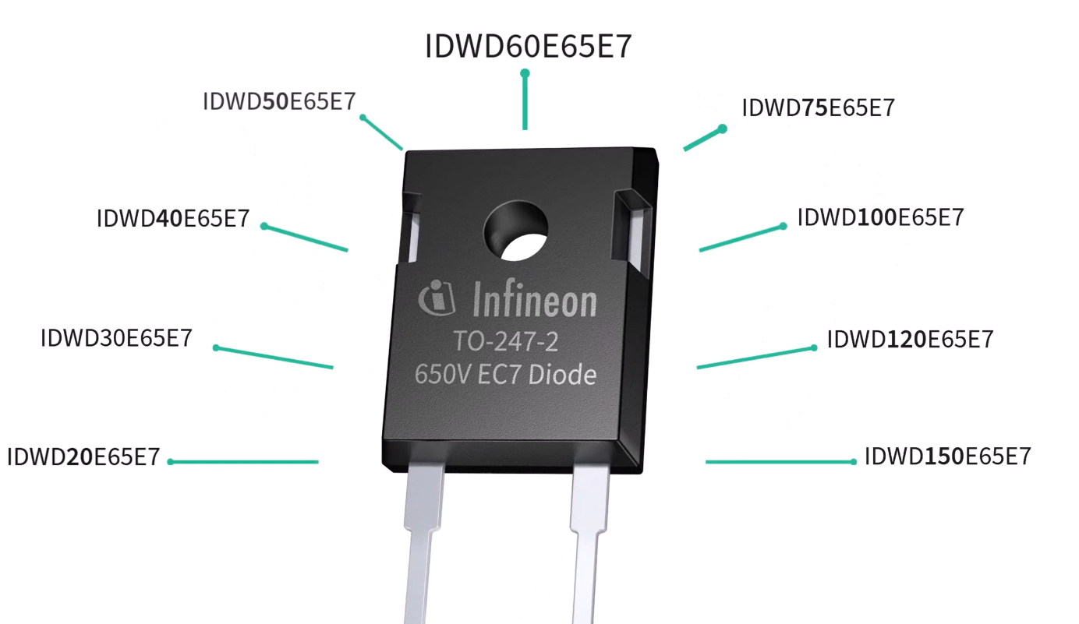
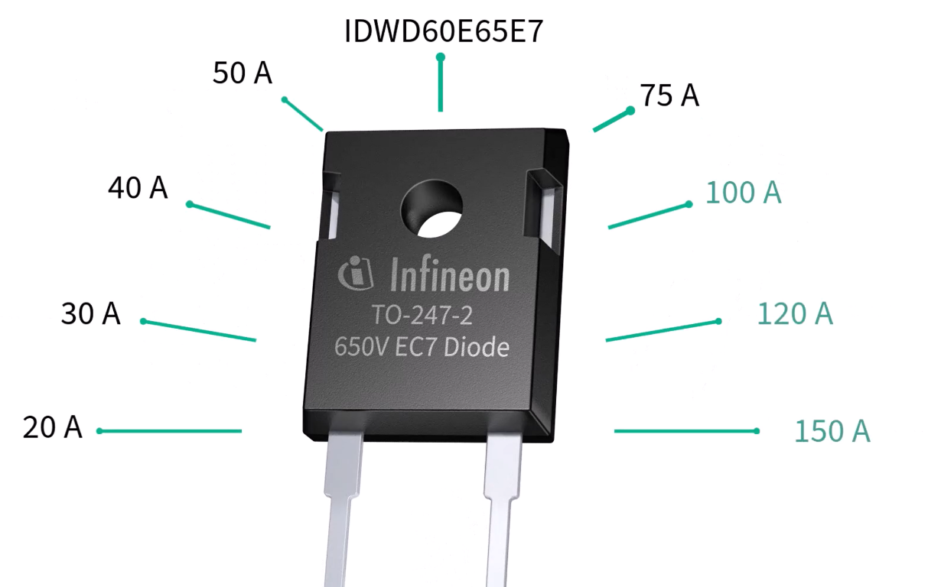

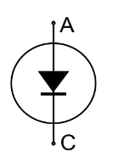

650 V emitter controlled 7 discrete diode
The same diode is copacked with
650 V IGBT7 H7 and T7
Notes:
9 products

Slide 16
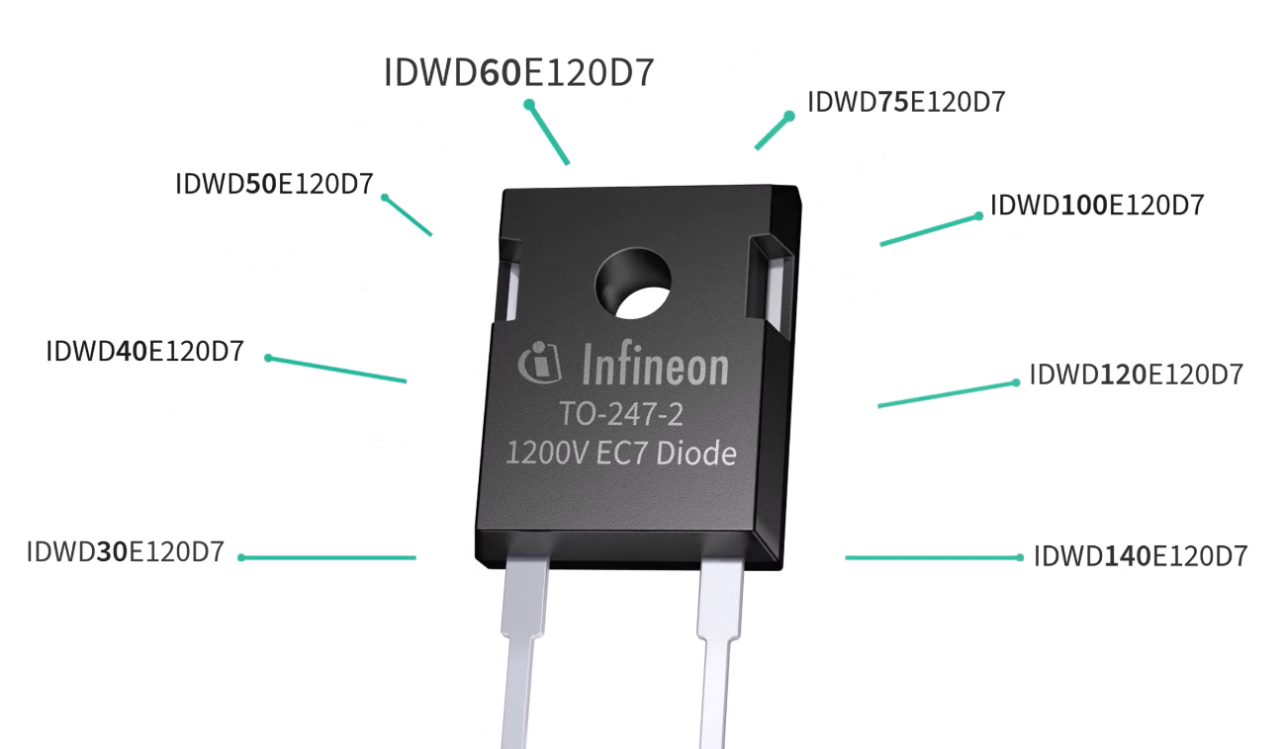
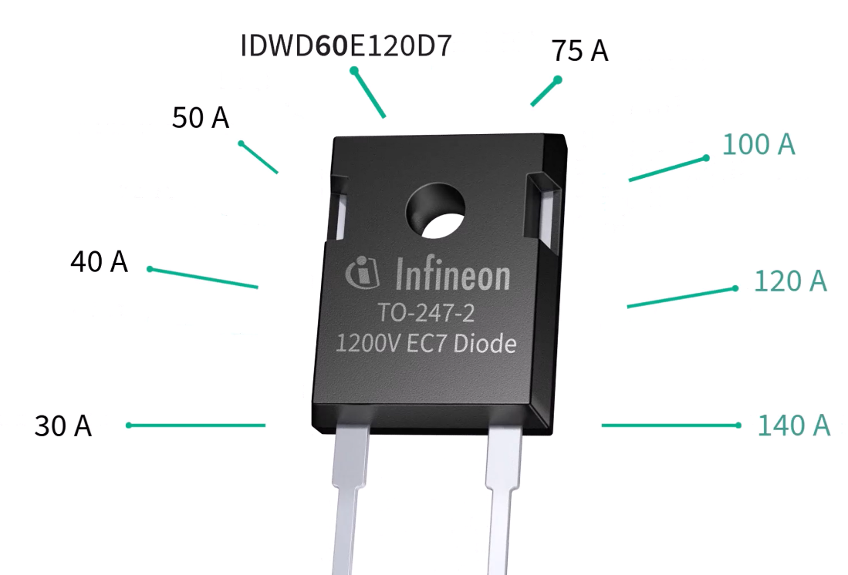
1200 V emitter controlled 7 discrete diode
The same diode is copacked with
1200 V IGBT7 H7
Notes:
8 products

Slide 17
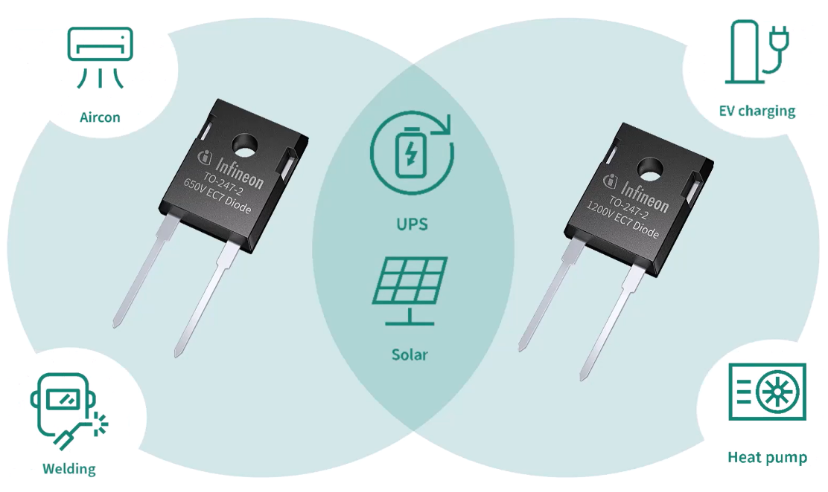
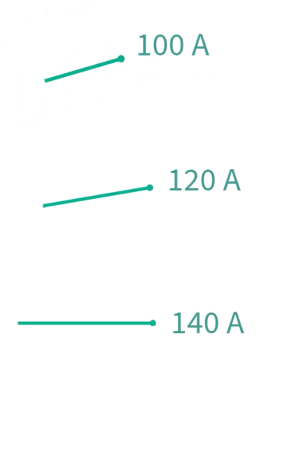
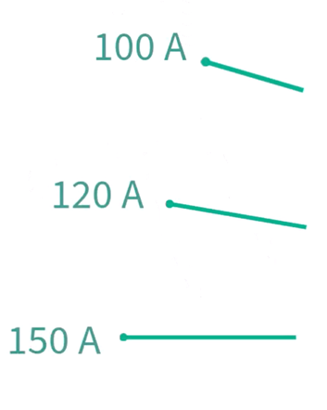


650 V emitter controlled 7 discrete diode

Slide 18

Technology background
The two flavours of

Slide 19








Industrial applications trade-off curves IGBT flavors for different applications and voltage classes
S7
Switching losses
[E_{tot}]
Short circuit rated
H7
T7
1200V
H7
750V
H7
650V
<= Low switching 20 kHz
Fast switching up to 20-100 kHz =>
Conduction Losses
[V_{ce(sat)}]

Slide 20




Industrial applications trade-off curves Diode flavors for different applications and voltage classes
Soft diode
Switching losses
[Q_{rr}]
Snappy diode
EC_{S7}
EC_{H7}
1200V
<= Low switching 20 kHz
Fast switching up to 20-100 kHz =>
Conduction Losses
[V_{F}]

Slide 21
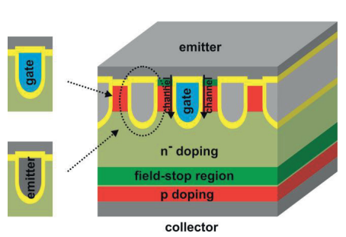

Infineon´s TRENCHSTOP™ IGBT7 What is new
Channel width engineering:
S7 balance short circuit and pulse-current requirements
H7 the steepest transfer characteristics
Channel distribution optimized for improved carrier confinement balancing:
V_{CE(sat)} (main focus of S7)
E_{off} (main focus of H7)
Dummy gate
Emitter trenches
Dynamic performance | C_{GE} | C_{CE} | C_{CG}
Active gates
Dummy gates
Emitter
Gates/Emitter ratio
Main Influence Secondary influence
What is the Micro-Pattern-Trench (MPT)?
Trench potentials designed for optimal capacitance behavior
Notes:
The proposed IGBT structure is based on micro-pattern trenches as shown in the top right corner drawing. In contrast to former Infineon technology, trenches can be utilized in several ways
As active channel → active gate
As dummy gate
As and emitter trenches
These three trench-cell building blocks allow tailoring the IGBT design, particularly the ratio active and dummy gate versus emitter trenches influence the capacitive coupling between collector and gate.
In the article mentioned, it has been demonstrated that the collector gate capacitance is mainly influencing the controllability, thereby the trade-off design of the Infineon IGBT7 S7 enhances softness during switching events maintaining low static losses and short circuit robustness.

Slide 22
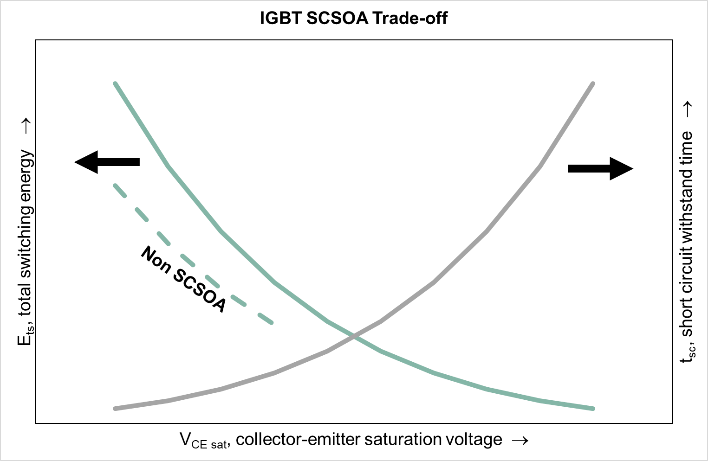
Infineon´s TRENCHSTOP™ channel width engineering
Channel width
SCSOA rated IGBT has higher V_{CE(sat)} and E_{ts} than equivalent part with no SCSOA rating
Saturation current needed
→ Smoother transfer characteristics
→ Short circuit withstand time
Thinner
S7
Larger
No saturation current needed
→ Steeper transfer characteristic
→ No Short circuit withstand time
H7
Notes:
The proposed IGBT structure is based on micro-pattern trenches as shown in the top right corner drawing. In contrast to former Infineon technology, trenches can be utilized in several ways
As active channel → active gate
As dummy gate
As and emitter trenches
These three trench-cell building blocks allow tailoring the IGBT design, particularly the ratio active and dummy gate versus emitter trenches influence the capacitive coupling between collector and gate.
In the article mentioned, it has been demonstrated that the collector gate capacitance is mainly influencing the controllability, thereby the trade-off design of the Infineon IGBT7 S7 enhances softness during switching events maintaining low static losses and short circuit robustness.

Slide 23

5 values of discrete IGBT7 family
Ease of use – „Simplicity“
Power density – „Space Minimization“
Efficiency – „Optimization“
System cost - „Affordability“
Quality – „Robustness“

Slide 24

Ease of use – „Simplicity“
Easy to replace older technology
Controllability at its finest
Ruggedness in every condition

Slide 25
Easy to replace older technology

Slide 26

The never-ending debate: current density vs. thermal performance Can newer technology replace the older one?
Chip & system current density
Do I get the same output power
Chip current density
R_{(th)JC} goes higher
Yes!
and even more!
How?
Parameter | Value | Unit
DC bus voltage | 800 | V
Modulation _{(SPWM)} | 60 | %
Electrical frequency | 50 | Hz
Cos(phi) | 0.9 | -
Newer technology
Lower losses
Chip & system current density
→
S7 shows better performance (I_{outMax})to T2 and H3.
The S7’s higher current density is perfectly compensated by the
lower static-dynamic losses.

Slide 27
Controllability at its finest

Slide 28
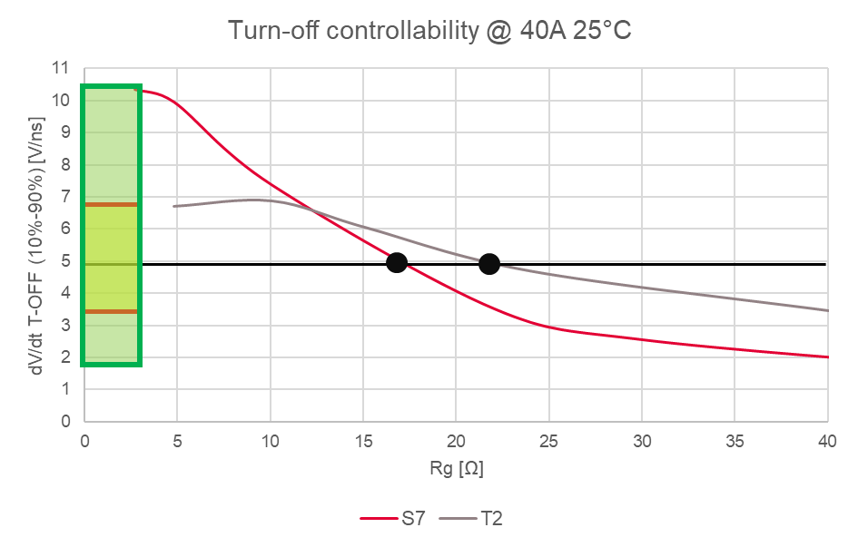
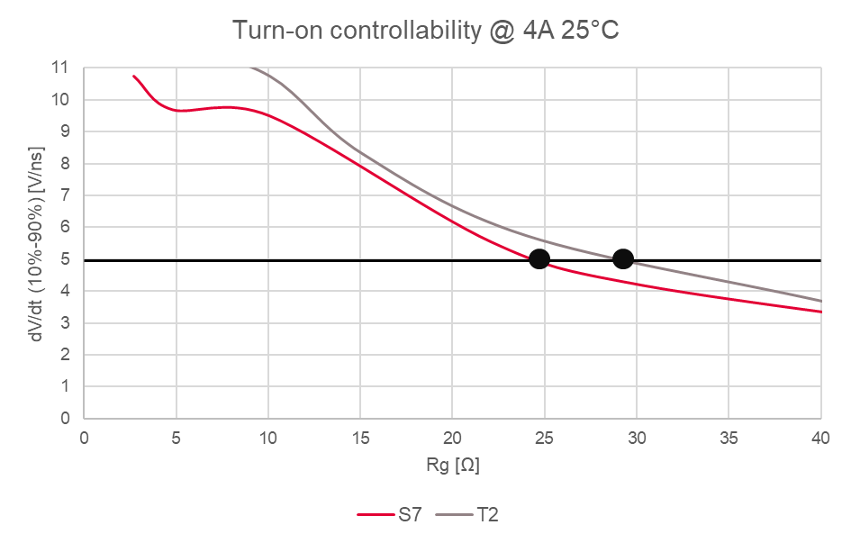
Controllability and gate drive resistor selection
High Gate drive resistor Low
Low dV/dt High
Enlarged controllability
Low Insulation stress High
High Dynamic losses Low
Requirement for GPD = 5 V/ns
→
The worst-case-scenario current and temperature wise:
The turn-on gate resistor ensures that the event is within the limit at low current (5/10% of the nominal current) and room temperature.
The turn-off gate resistor ensures that the event is within the limit at nominal current and room temperature.
Notes:
Why decrease the switching speed? Mainly to decrease stress in the machine insulation, due to voltage spikes.
How to do it? Increasing the gate drive resistor. Consequently the dV/dt slows down, but the total dynamic losses rise, especially during turn-on.
The dV/dt slope is also influenced by other boundary conditions, such as the collector current and device temperature. Thus, the selection of the turn-on gate resistor ensures that even at low current and low room temperature the event is sufficiently “soft”. While the turn-off gate resistor selection ensures that at nominal current and low room temperature the event is sufficiently “soft”.
The dV/dt of the devices under test are plotted in the figure and the gate resistances selection summarized in the table. As we can clearly see, fast trade of device as the one of the competitor X needs higher gate resistor to fulfill the requirement, while slower trade off components as the device of the competitor Y and the Infineon IKW40N120CS7 easily reach the goal with moderate magnitude.

Slide 29
Ruggedness in every condition

Slide 30
How to deal with short circuit withstand time?
The Infineon datasheet provides the short circuit current and withstand time as a function of gate-emitter voltage t_{SC} = f(V_{GE}) for the worst case of 150°C.
However, short circuit current I_{SC}, consequently t_{SC}, strongly depends on the bus voltage (V_{CC}) and the T_{vj} as well.
Infineon already applies a ~25% safety margin in the t_{SC} datasheet value!

Slide 31
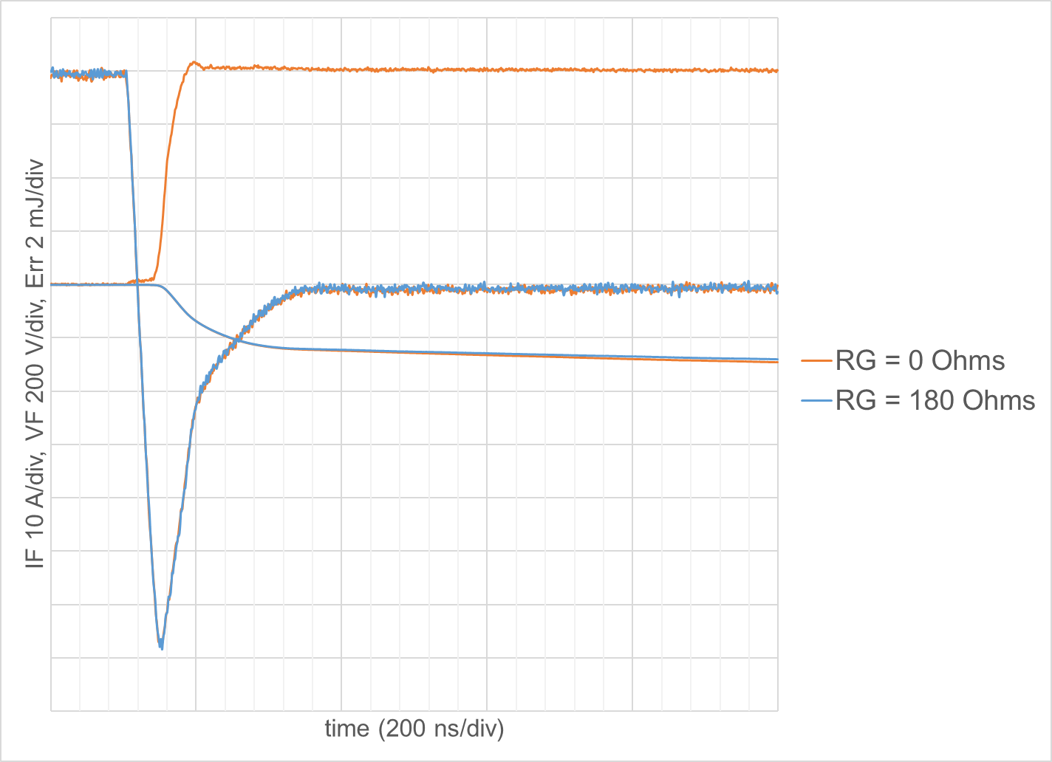

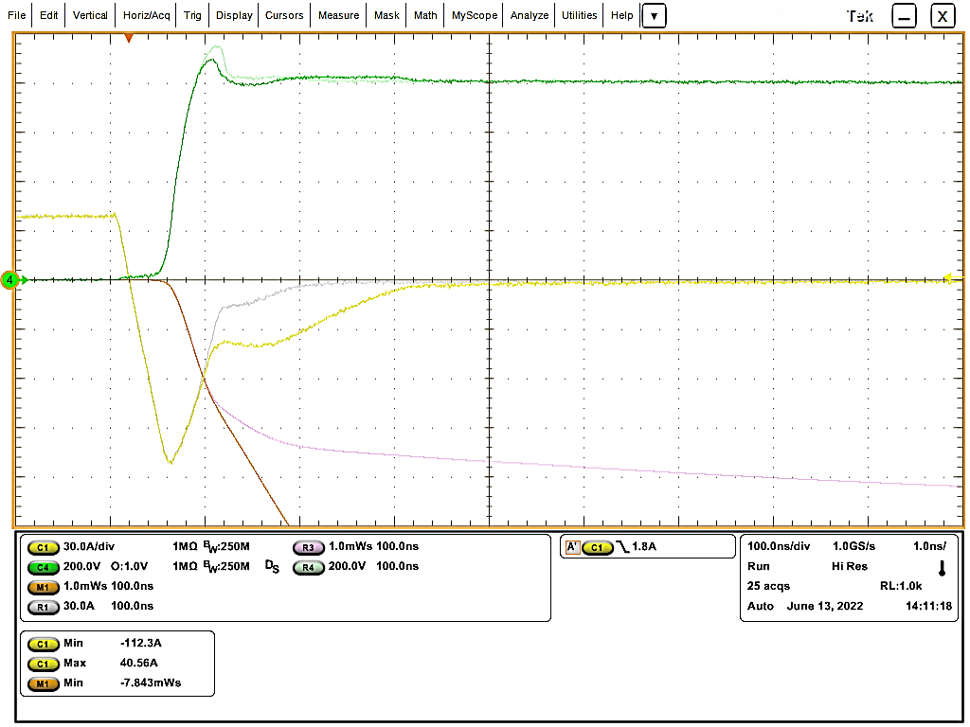

Parasitic turn-on performance Test results
RG_{_OFF HS}
Test conditions: dv/dt ~ 36 kV/us (low side) V_{CC} = 800 V T_{J} = 175°C
I_{F}
Diode recovery voltage, V_{F}
36 kV/us
PTO failure sample (competitor)
No Q_{rr} and/or E_{rr} difference between
R_{G_OFF HS} = 0 Ω vs. 180 Ω
dv/dt
Diode recovery voltage, V_{F}
E_{rr}
Clear change in Q_{RR}/E_{RR}
I_{F}
Q_{rr} at R_{G_OFF HS} = 0 Ω
No change in Q_{RR}/E_{RR}
Q_{rr} at R_{G_OFF HS} = 47 Ω
E_{rr} at R_{G_OFF HS} = 0 Ω
E_{rr} at R_{G_OFF HS} = 47 Ω

Slide 32

Power density – „Space minimization“
Notes:
Include ePA measurement

Slide 33
Trends and challenges in paralleling
Why its important?
Increasing power density
Increasing output power
Reducing the risk
P
S2…Sn
S3…Sn
S1...Sn
...
What are the challenges?
multi-phases
0
Static sharing
Dynamic sharing
S4...Sn
How to solve?
N
Design
Symmetrical
Sorting
3L – NPC2
Notes:
Before we jump into the power density and their outcome let’s have a deeper look into the system trends using discrete devices and how the IGBT7 address all the challenges in the design.
As the trend, we see more and more discrete devices are used in many applications by increasing the power density and output power. This trend is met in different ways, either by using high-current class devices and reducing the risk of paralleling or by paralleling and reducing the thermal stress on each device.
Symmetry in all Aspects – PCB design and Device parameters
With a symmetrical PCB design, we can avoid the issues of paralleling
Several parameters of the device will also play a crucial role

Slide 34
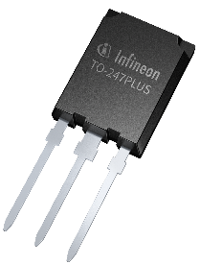
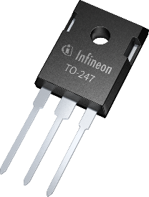
Boost power density and enable size frame jump
Parameter | Value | Unit
V_{DC} | 600 | V
Heat sink temp. | 100 | °C
Switching freq. | 6000 | Hz
Output freq. | 50 | Hz
Mod. index | 100 | %
Cos(phi) | 0.9 | -
Rg | As per datasheet value | -
Boost up to 120%
power density
→
Main value proposition driven by demand of increased power density:
Boost your power density up to:
~75% with the same thermal design
~120% with improved thermal design
Enabling enable frame-size jump
Reference: IKW40N120CS7
With Sil-Pad K10
Notes:
As we know power density is one of the main value proposition that all designers consider during their system design face, how the IGBT7 will help this? There where the high current density devices comes into play which results in having a high current class devices in the system. So here we have one of the examples showing the power density increase in drives application where the 40A 3pin is took as a reference in comparison to 75A, 100A and 120A devices where two different thermal interface materials are also evaluated with the standard boundary conditions for the drives as shown in the left. From this we can clearly see that using a 120A device we can boost upto 74% power density using silion pad and upto 120% using ceramic. Which clearly states that we can empower the system for higher power rating with the same system size.

Slide 35


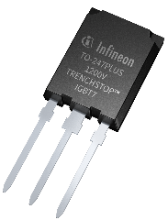
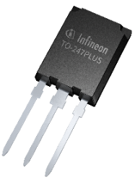
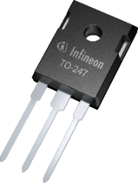
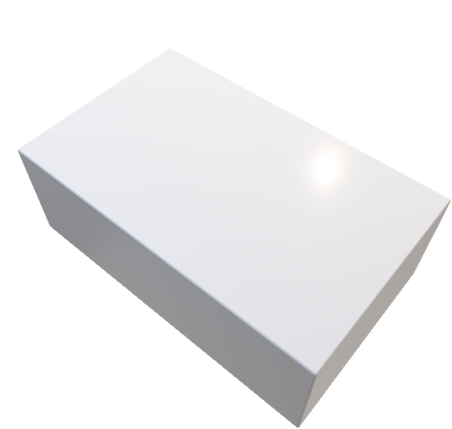
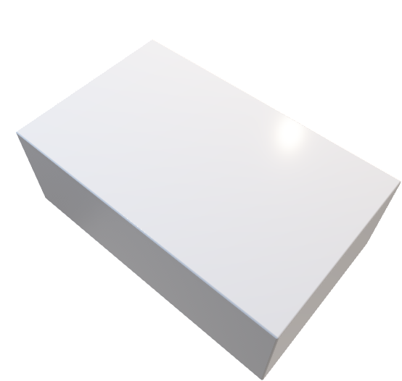
Internal and external fighting guide – TO-247 PLUS
Size reduction
more power
IGBT7:
Can replace 2 parallel 40 A rated devices from competitor
→
TRENCHSTOP™ IGBT7
Increased power density
Size reduction more power
Notes:
An another advantage of having higher current class devices is that we can reduce the risk of paralleling which was explained earlier which is also linked to the power density. In this graph you can see the outcome of 1 - 75A vs 2 – 40A devices of two different competitors where you clearly see the 75A IGBT7 can replace 2-40A devices from the competitor under the same test condition and also with the thermal interface material not only against competitor but also against pervious generation of IGBT from Infineon. In the end we can see that high current class devices of IGBT7 can helps in boosting the power density with higher performance. On the other hand its also wort to note that with higher current class devices there is also we brighter possibility to increase the output power of the system by having parallel device for eg. We can reach ~200kW with 4*140A in parallel.

Slide 36

Efficiency – „Optimization“
Notes:
Include ePA measurement

Slide 37

Trade-off chart Key parameters – comparison
Micro-pattern-trench
Qrr vs VF
No saturation
T2
S7
H3
650 V
750 V
S6
H7
down to ~50% lower switching losses
down to ~20% lower conduction losses
L5
T7
1200 V
S5
H5
H7 – 650 V
H7 – 750 V
Higher efficiency
Output power
Lower temperature
*note – DUT – 75A 3pin devices
Notes:
650 V IGBT co-pack with EC7 Rapid Diode technologies shows better tradeoff performance versus previous generation IGBT5 - S5/H5
1200 V IGBT co-pack with EC7 Rapid Diode technologies shows better tradeoff performance versus previous generation IGBT – S6/H3 (with Short circuit withstand time)
Test condition for 650V– Vbus – 400V, Vge -0/15V, Rg – 10ohms, Temp – 175°C
Test condition for 1200V– Vbus – 600V, Vge -0/15V, Rg – 10ohms, Temp -175°C
In general, IGBT H7 shows lower Eon and higher Eoff losses, Resulting in lower total switching losses Ets for IGBT7 H7

Slide 38
New vs. old technology
How does new discrete IGBT7 compare to predecessor generations
G
C
E
Lower temperature
Higher efficiency
Higher power output
1.2%
20°C
13°C

Slide 39
Maximum efficiency with 4-pin solution

Slide 40
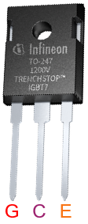
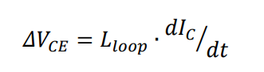
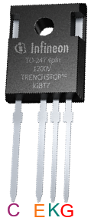
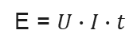
Difference – 3-pin vs. 4-pin
How does this influence anything?
C
Controllability
Lower turn-on losses
Lower junction temperature
G
E
C
Power loop
+
Control loop
108 A/ns
G
0.8 A/ns
K
E
Appnote 3pin vs 4 pin
E = $U∙I∙t$
Notes:
With 4 pin you benefit much compared to the 3 pin for eg. With lower the rg and higher the current the system losses will be lower

Slide 41
Product and application benefits: IKW40N120CH7 vs IKZA40N120CH7
15°C
G
C
E
C
E
K
G
0.1%
~ 30% lower losses
~ 19% lower case temperature
~ 17% more output current
~ 30% dv/dt or di/dt
4-Pin
3-Pin
→
IGBT7 is faster compared to previous generations.
The 4-pin devices are suggested to have better controllability and to
achieve higher dv/dt or di/dt.
The test conditions
I_{out}= 20 Arms, Vout = 230V_{RMS}, Vin = 800V, Fpwm = 33.3 kHz, Pout = 4kW, Tj=130°C, Rg(on/off) = 10 ohm

Slide 42

System cost – „Affordability“
Notes:
Include ePA measurement

Slide 43

IGBT7: The cost-effective alternative to wide-bandgap solutions
Older discrete silicon technologies
2016 – Gen1
2024 – Gen2
2007-2012
Wide-bandgap
TRENCHSTOP™
Discrete IGBT7 is
bridging the gap between traditional silicon IGBTs and offering a cost-effective alternative to wide-bandgap solutions
TRENCHSTOP™ 2
Highspeed 3
TRENCHSTOP™ performance
System cost
TRENCHSTOP™ IGBT 6
TRENCHSTOP™ 5
2021-2025
61 products
Performance
Notes:
"Get the best of both worlds with IGBT7 - combining the reliability of traditional Silicon IGBTs with the efficiency of widebandgap solutions."
"Experience the power of innovation with IGBT7 - the perfect solution for modern power designs."
"Step up your power game with IGBT7 - the future of efficiency and cost-effectiveness."
"Say goodbye to trade-offs with IGBT7 - the ultimate solution for high-performance power designs."
"Choose IGBT7 for superior power performance at an affordable price point - bridging the gap in today's power market."

Slide 44
1200 V IGBT7 vs. SiC MOSFET positioning
Out Current
Efficiency
CoolSiCTM MOSFET
TRENCHSTOPTM IGBT7 H7
Discrete IGBT7 is
bridging the gap between traditional silicon IGBTs and offering a cost-effective alternative to wide-bandgap solutions
TRENCHSTOPTM IGBT7 H7
CoolSiCTM MOSFET
IGBT
both
SiC MOSFET
20 kHz
40 kHz

Slide 45

Quality – „Robustness“
Notes:
Include ePA measurement

Slide 46


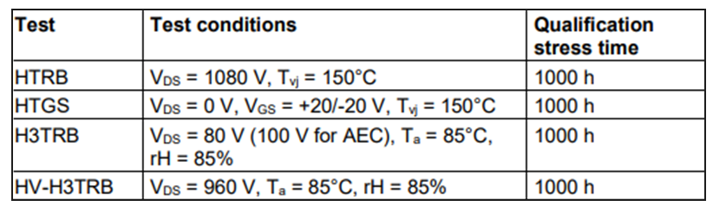
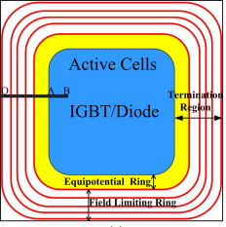
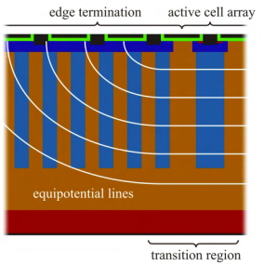
Quality requirement discretes
High Voltage at High Humidity
The robustness validation stess times
only
Improved Edge Termination
Why?
Corrosions at field plates
Corrosion of DLC film
Delamination in the passive layer
Corrosion at contacts
Suitable for outdoor applications
Solar
Industry air-conditions
Pump drives
etc.
Certified by JEDEC standard for HV-H3TRB
What
High voltage – high humidity high-temperature reverse bias storage
Hard failure of the devices and blocking voltage drifts down over time
JEDEC (Joint Electron Device Engineering Council)
Notes:
Why this are the failures that can happen
it is Humidity robust device and has enhanced cosmic ray robustness. It is the first time we´ve ever promote something like this. This is a key value differentiator from the competition on this topic. It is a new ring that goes around, basically humidity robustness if often effecting, it is like a junction between an isolation ring and active cell, but here sometimes short is happening, so then the device can be destroyed, but now this edge for IGBT7 is much more (further improved) robust.
Which is very important as drives are working in harsh industrial environemnt

Slide 47

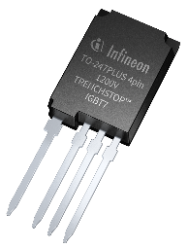

Key takeaways and resources
Flexible family that suits the overall energy chain needs
5 values of discrete TRENCHSTOP™ IGBT7:
Easy to switch, fine controllability with a rugged transient
Advanced power density
Level up efficiency with silicon world
Optimized price/performance, with a global responsibility
Extra reliability, qualified for HV-H3TRB
3 voltage classes 650 V, 750 V & 1200 V
3 flavours T7, H7 & S7
7 packages
61 Products
IGBTs produced in a
newest fully-automated
300mm chip factory
infineon.com/discreteIGBT7

Slide 48
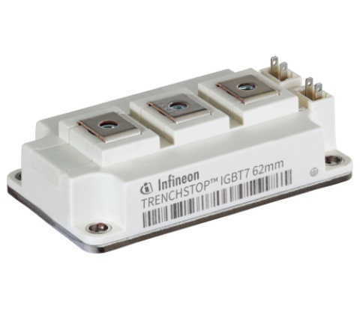
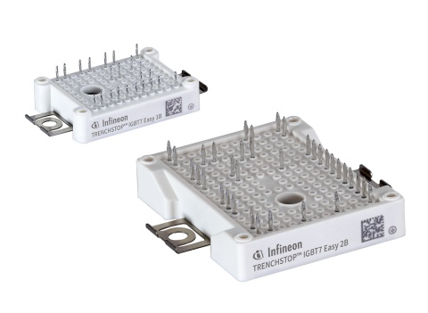





Complementary products
Every switch needs a driver
TRENCHSTOPTM IGBT7 modules
EiveDRIVERTM
&
Notes:
Goes hand in hand with Infineon gatedrivers

